Slide 1
HR Analytics Final Project
Muhammad Rizky Farhan
Purwadhika Data Science After Hour Bekasi

Slide 2
Contents
01
PROBLEM & GOALS
03
MODELING
Machine learning and feature importance
The context of the final project case
02
DATASETS
04
DASHBOARD APPLICATION
The data that is being used
Using flask application to predict new data

Slide 3
01
PROBLEMS & GOALS
The context of the final project case

Slide 4
PROBLEM
XYZ COMPANY
Employs around 4000 employees
Every year around 15% of it’s employees leave
The level of attrition (employee leaving) is bad for the company
The management wanted to understand what factors they should focus on

Slide 5
Identify what are the most significant factors affecting attrition and making a model to predict new employee’s attrition
GOALS

Slide 6
02
DATASETS
The data that is being used

Slide 7
DATASETS
SOURCE
ROWS
From kaggle.com “HR Analytics Case Study”
4410 rows of data
FEATURES
CLEANED
28 features of employee information
17 features with 4300 rows of data

Slide 8
03
MODELING
Machine learning and feature importance

Slide 9
MACHINE LEARNING ALGORITHMS
Logistic Regression
Decision Tree Classifier
Random Forest Classifier
AdaBoost Classifier
Gradient Boost Classifier
Extreme Gradient Boost Classifier
Naïve Bayes
K-Nearest Neighbour
Support Vector Classifier
Multi-Layer Perceptron

Slide 10
CHOOSING THE MODEL
EVALUATION
OPTIMIZATION
Comparing accuracy best scores
Tuning with GridSearchCV and oversampling

Slide 11
CHOSING THE MODEL
RANDOM FOREST
FEATURE SELECTION
Accuracy:
97,9%
01
02
03
RFC WITH SMOTE
SUPPORT VECTOR
Accuracy:
98%
Accuracy:
97,7%

Slide 12
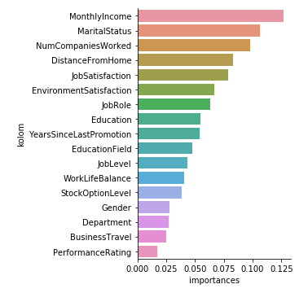
FEATURE IMPORTANCE
The features are ranked by their usefulness to predict the target value. The top 5 features are then selected for the final model.

Slide 13
04
DASHBOARD APPLICATION
Using flask application to predict new data

Slide 14
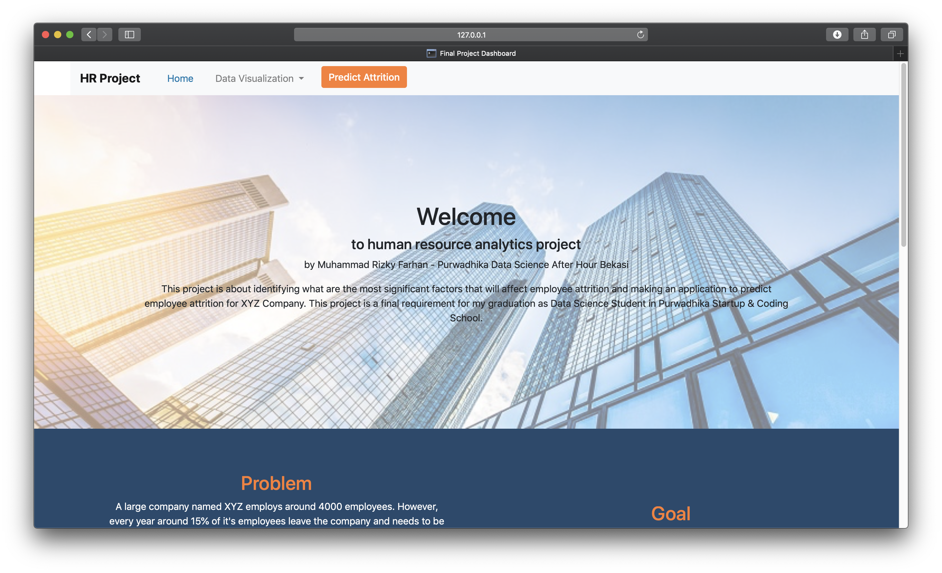
HOME

Slide 15
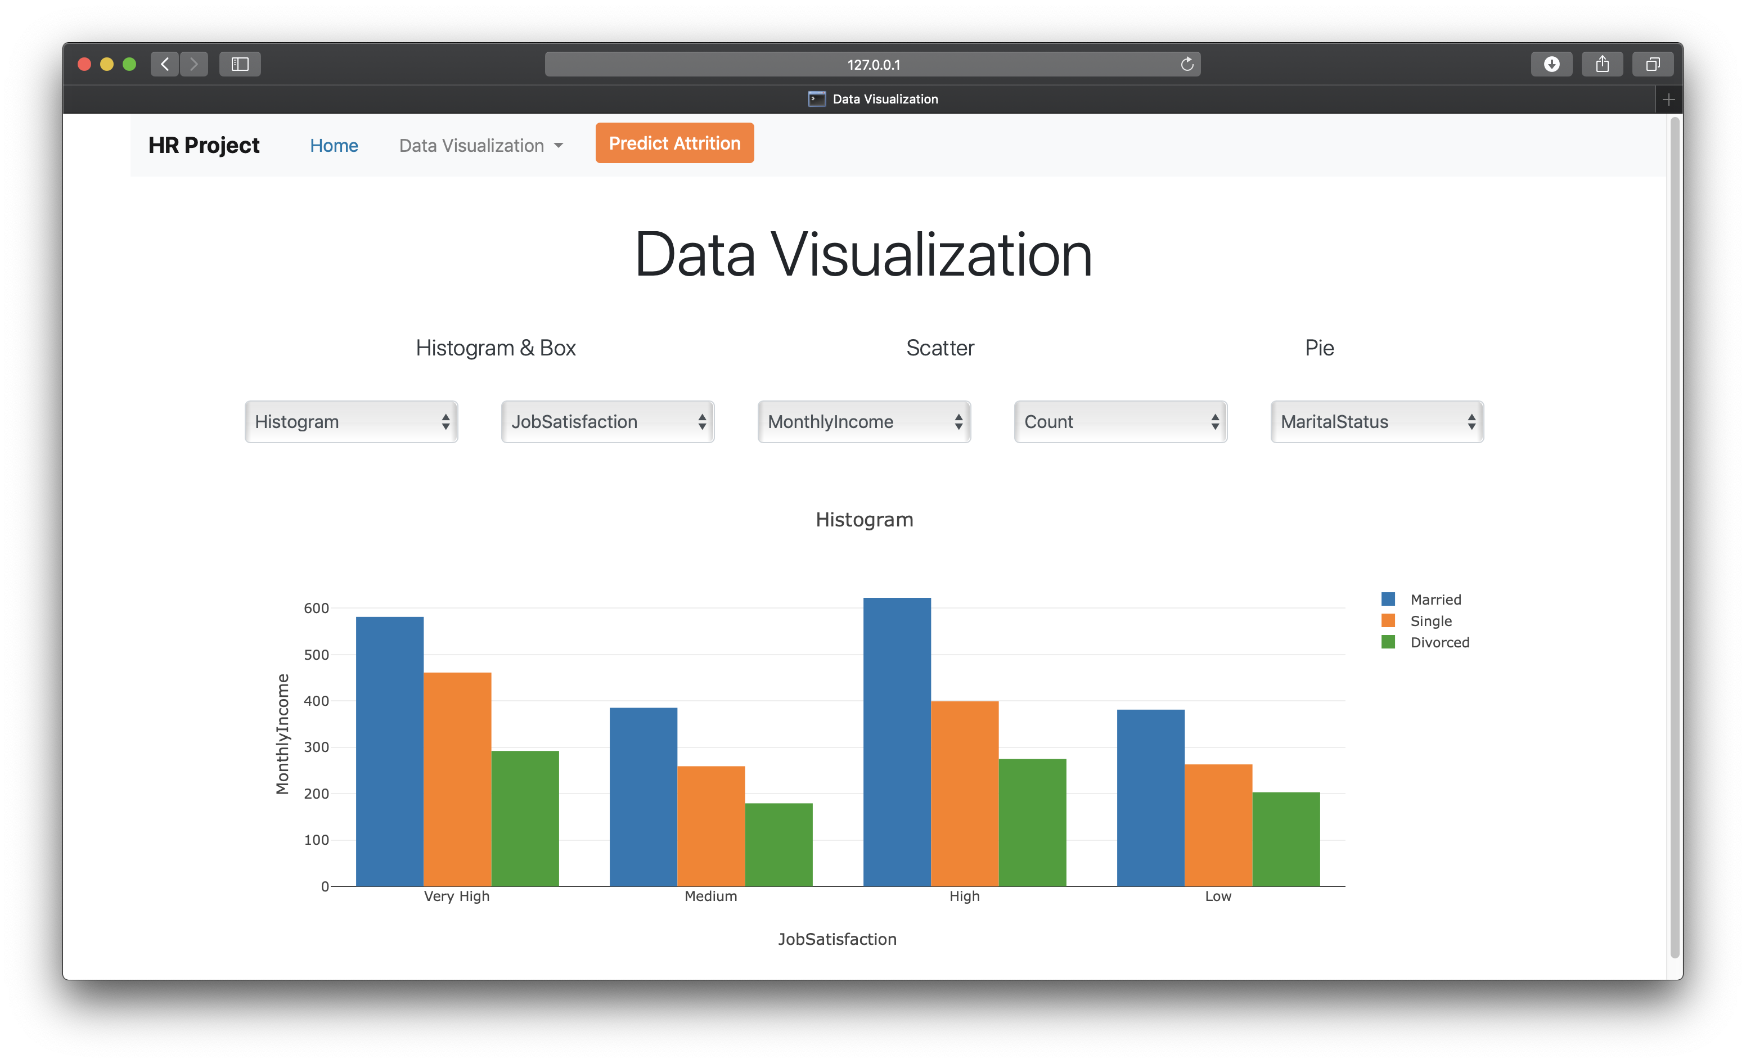
HISTOGRAM

Slide 16
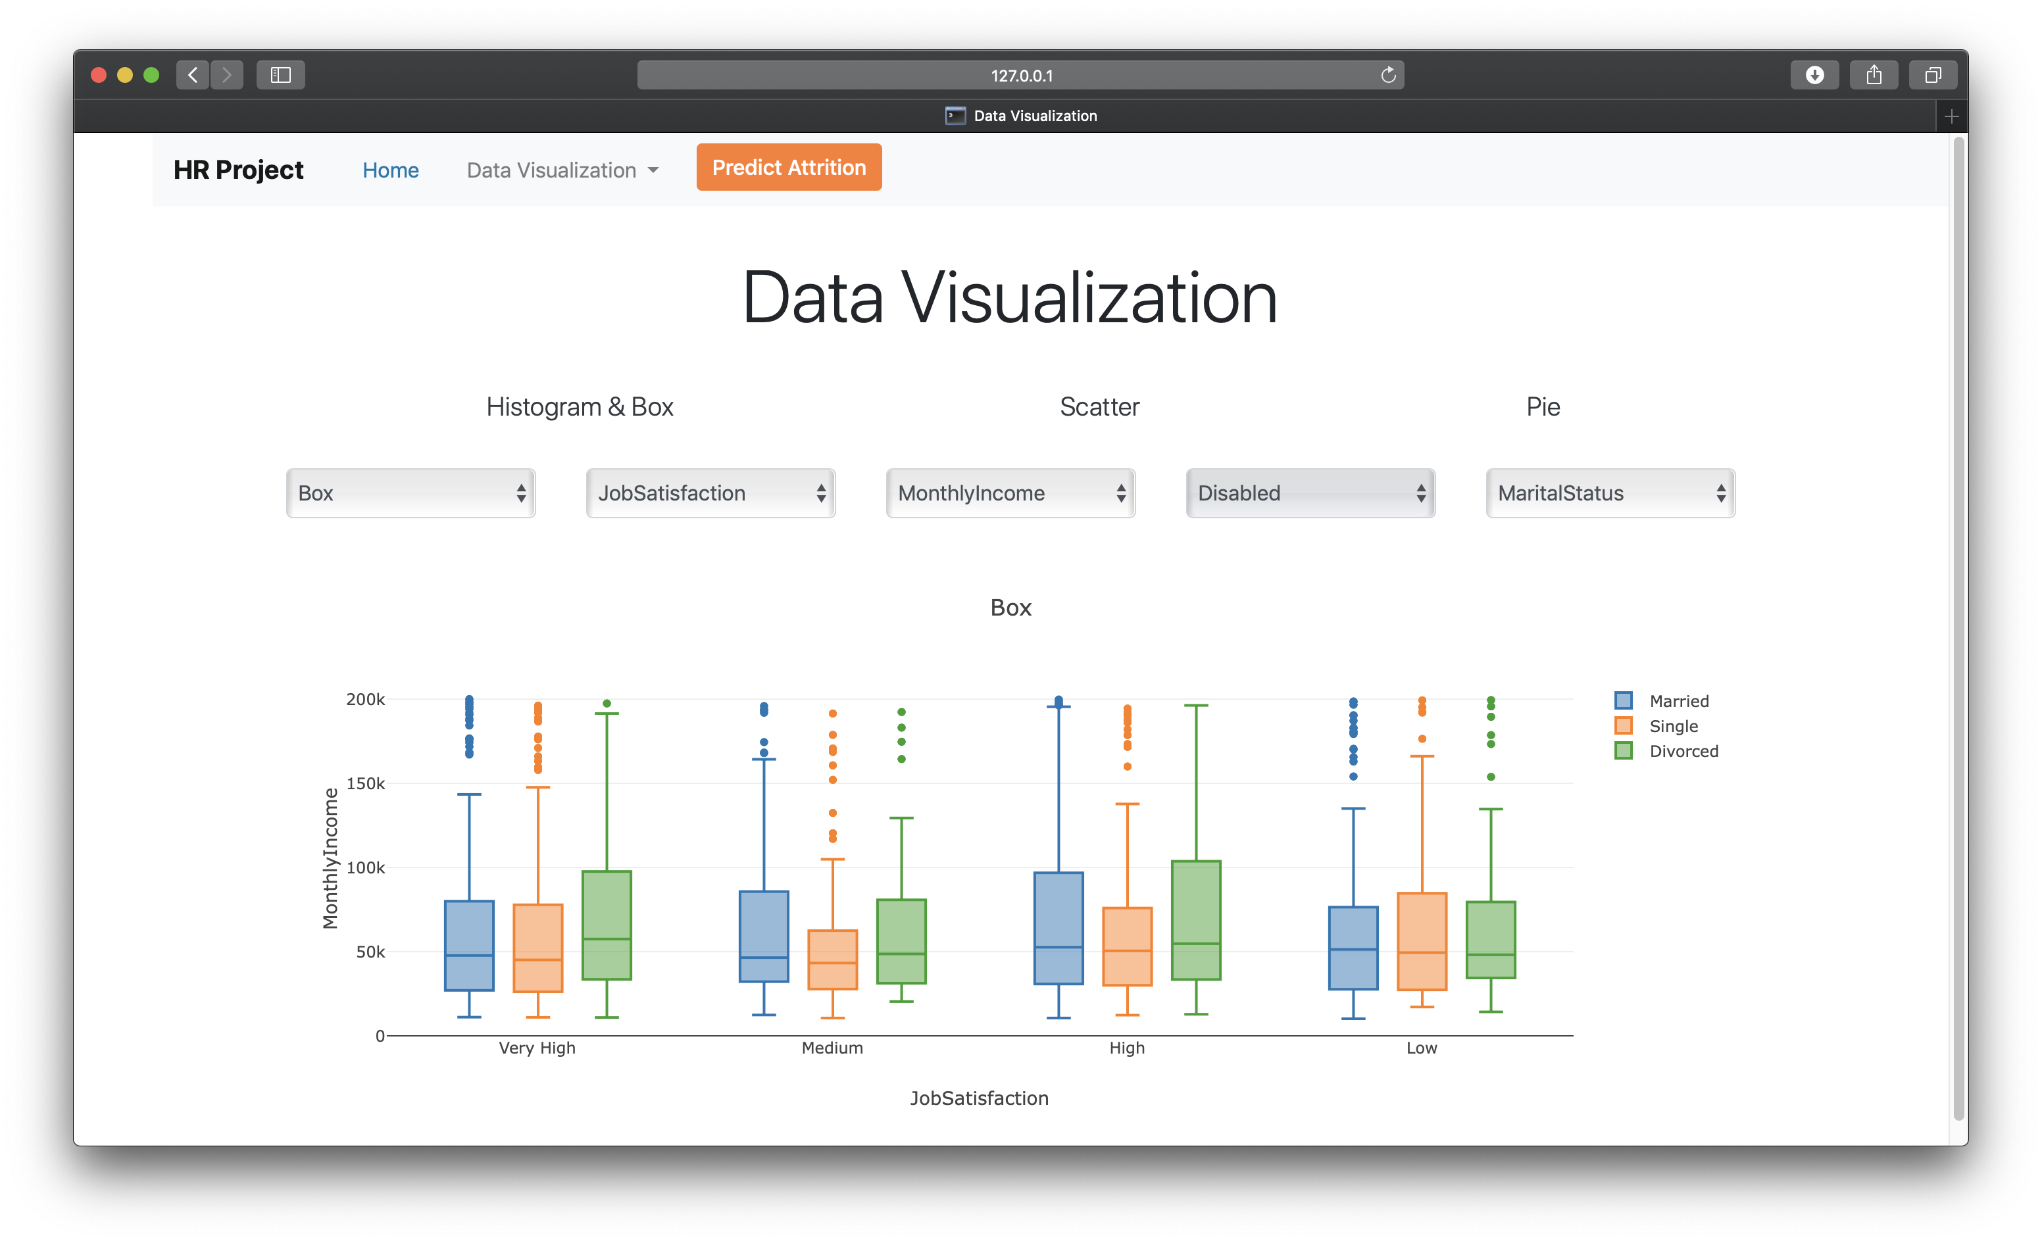
BOXPLOT

Slide 17
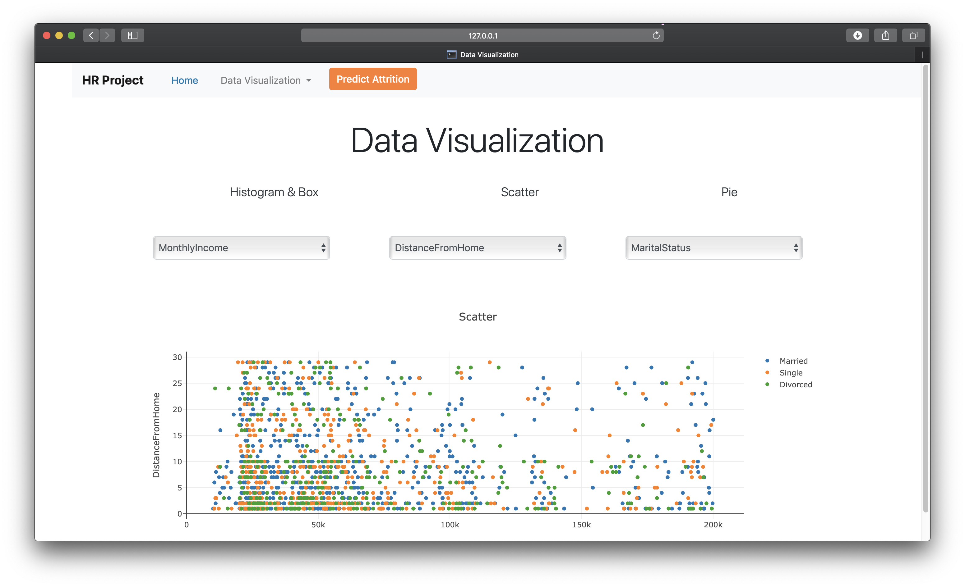
SCATTER PLOT

Slide 18
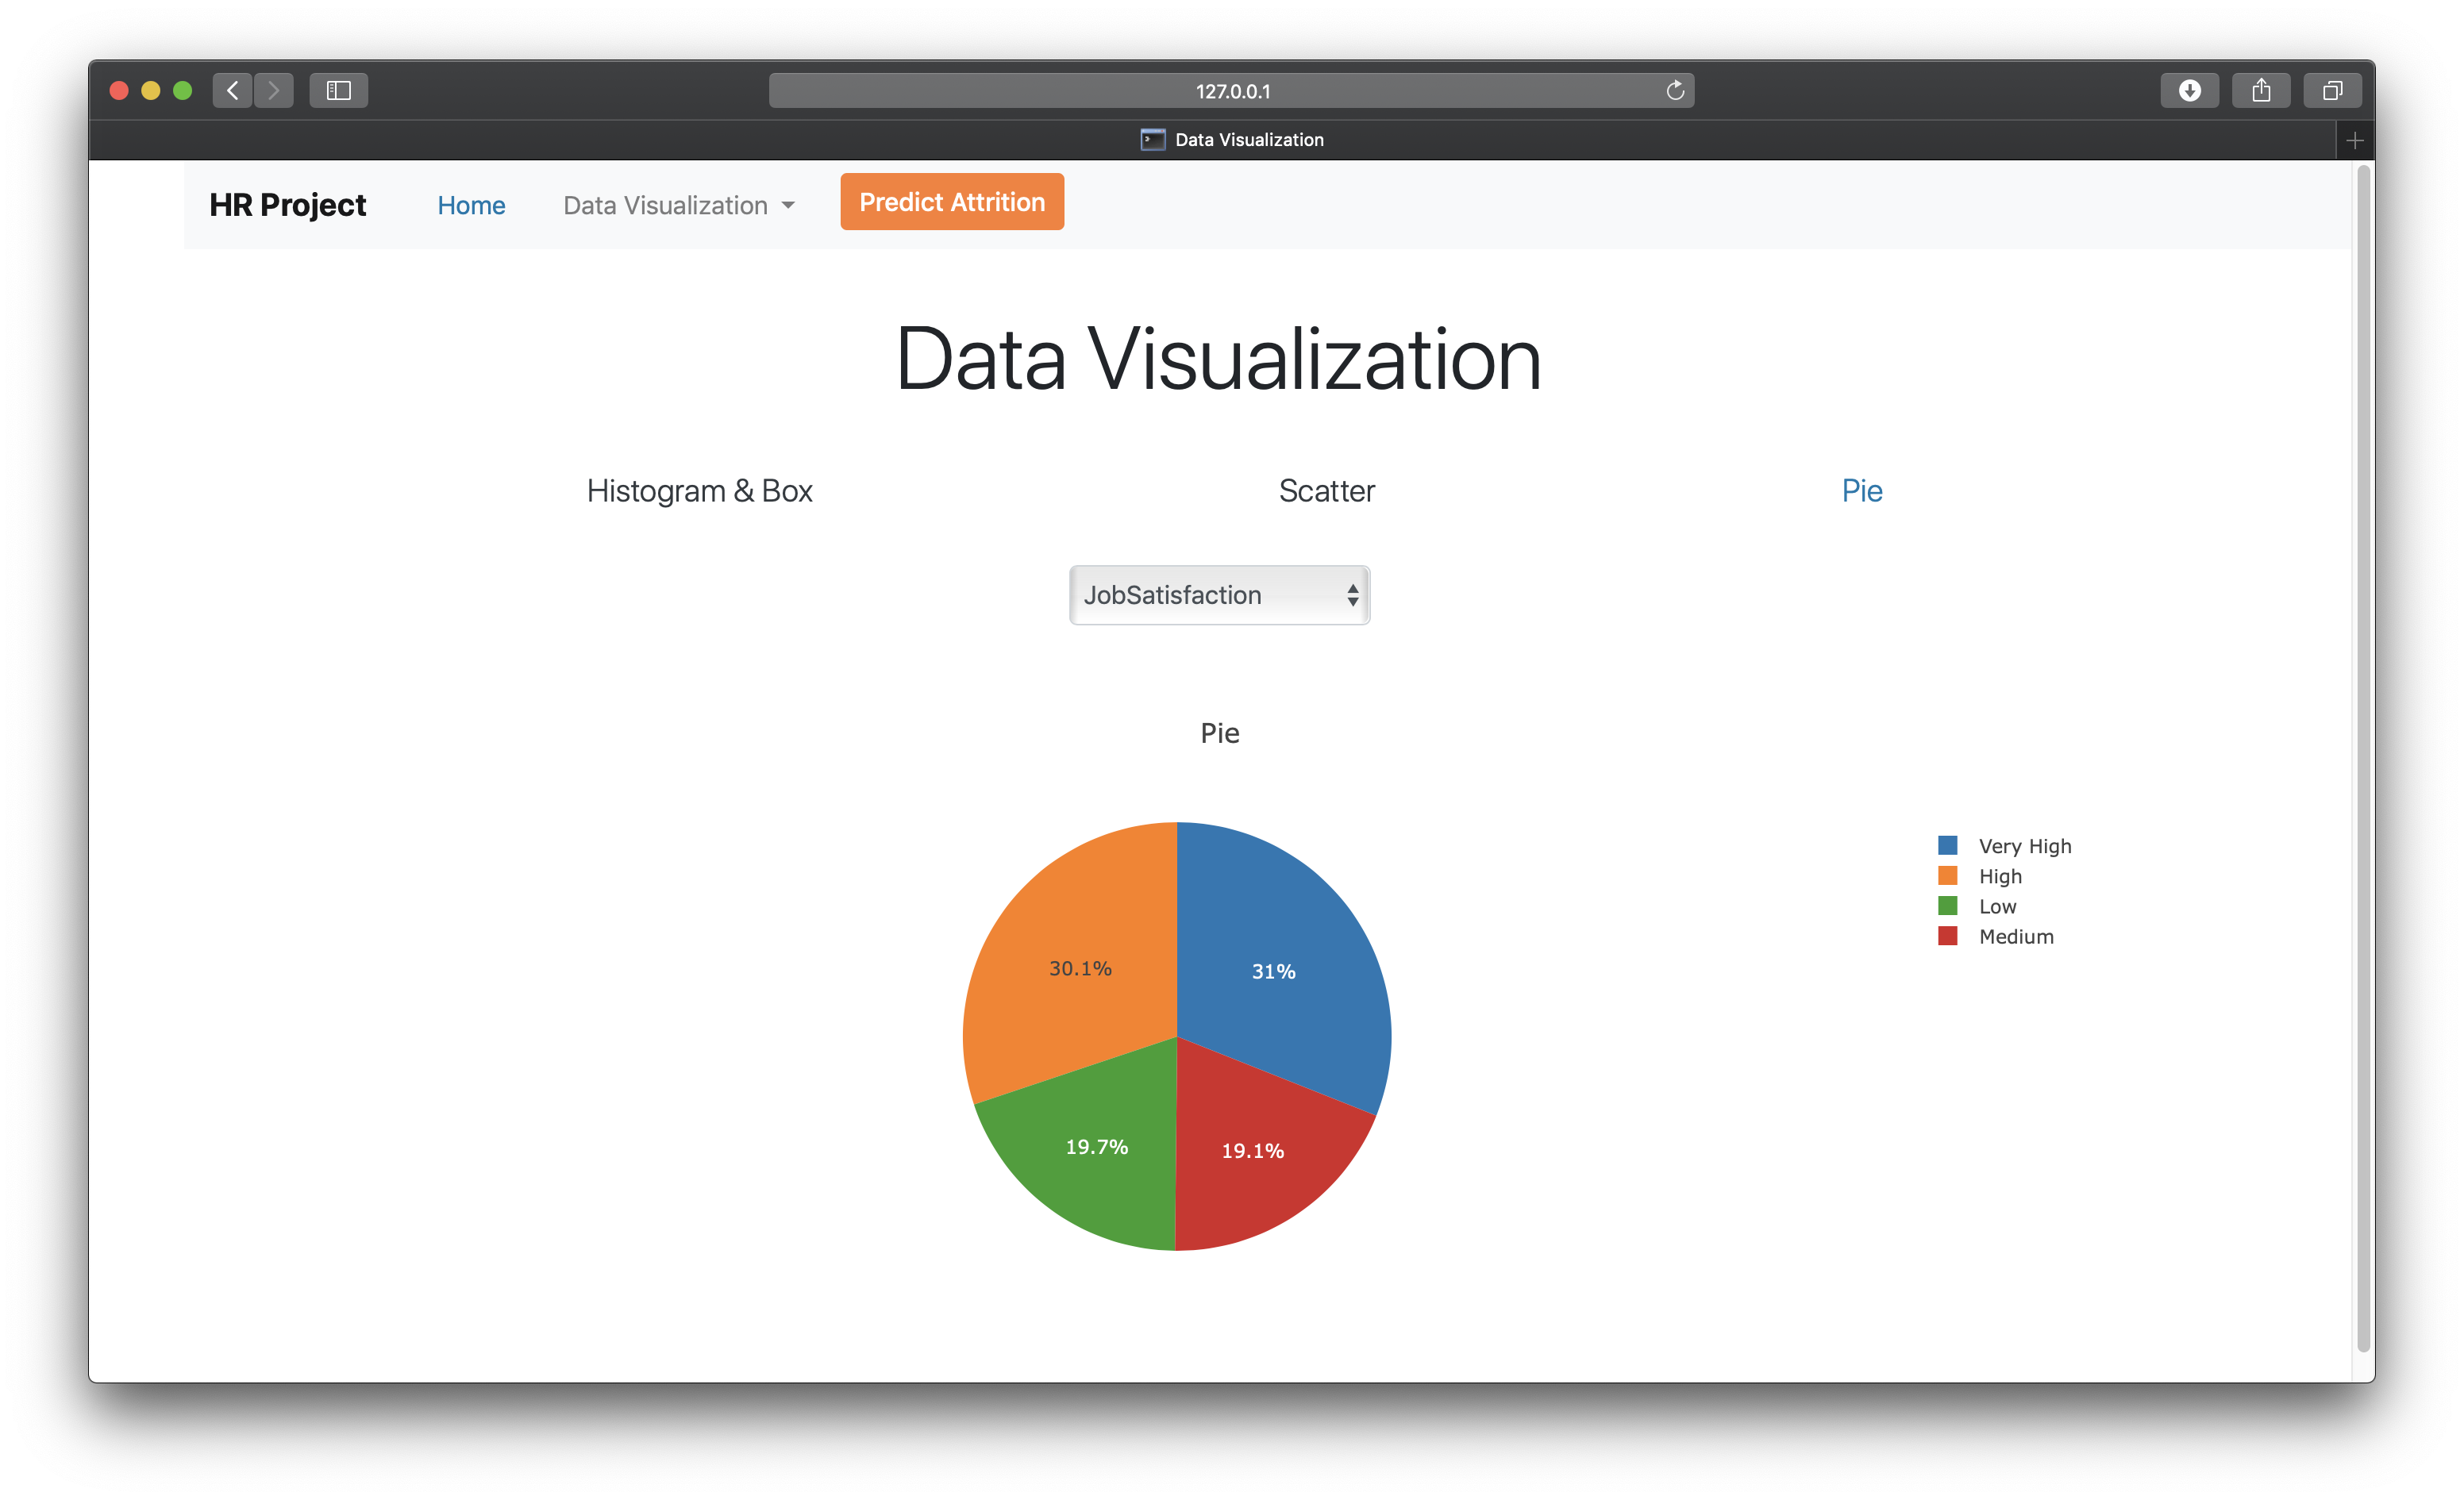
PIE PLOT

Slide 19
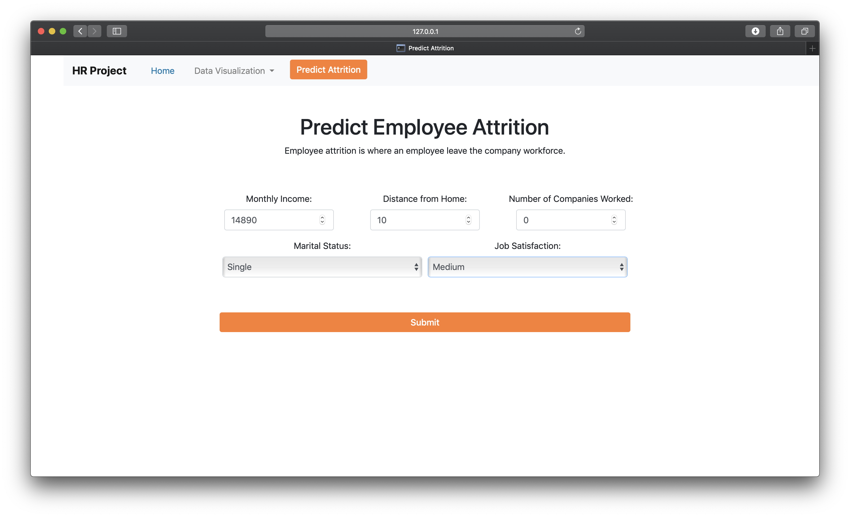
INPUT PREDICT DATA

Slide 20
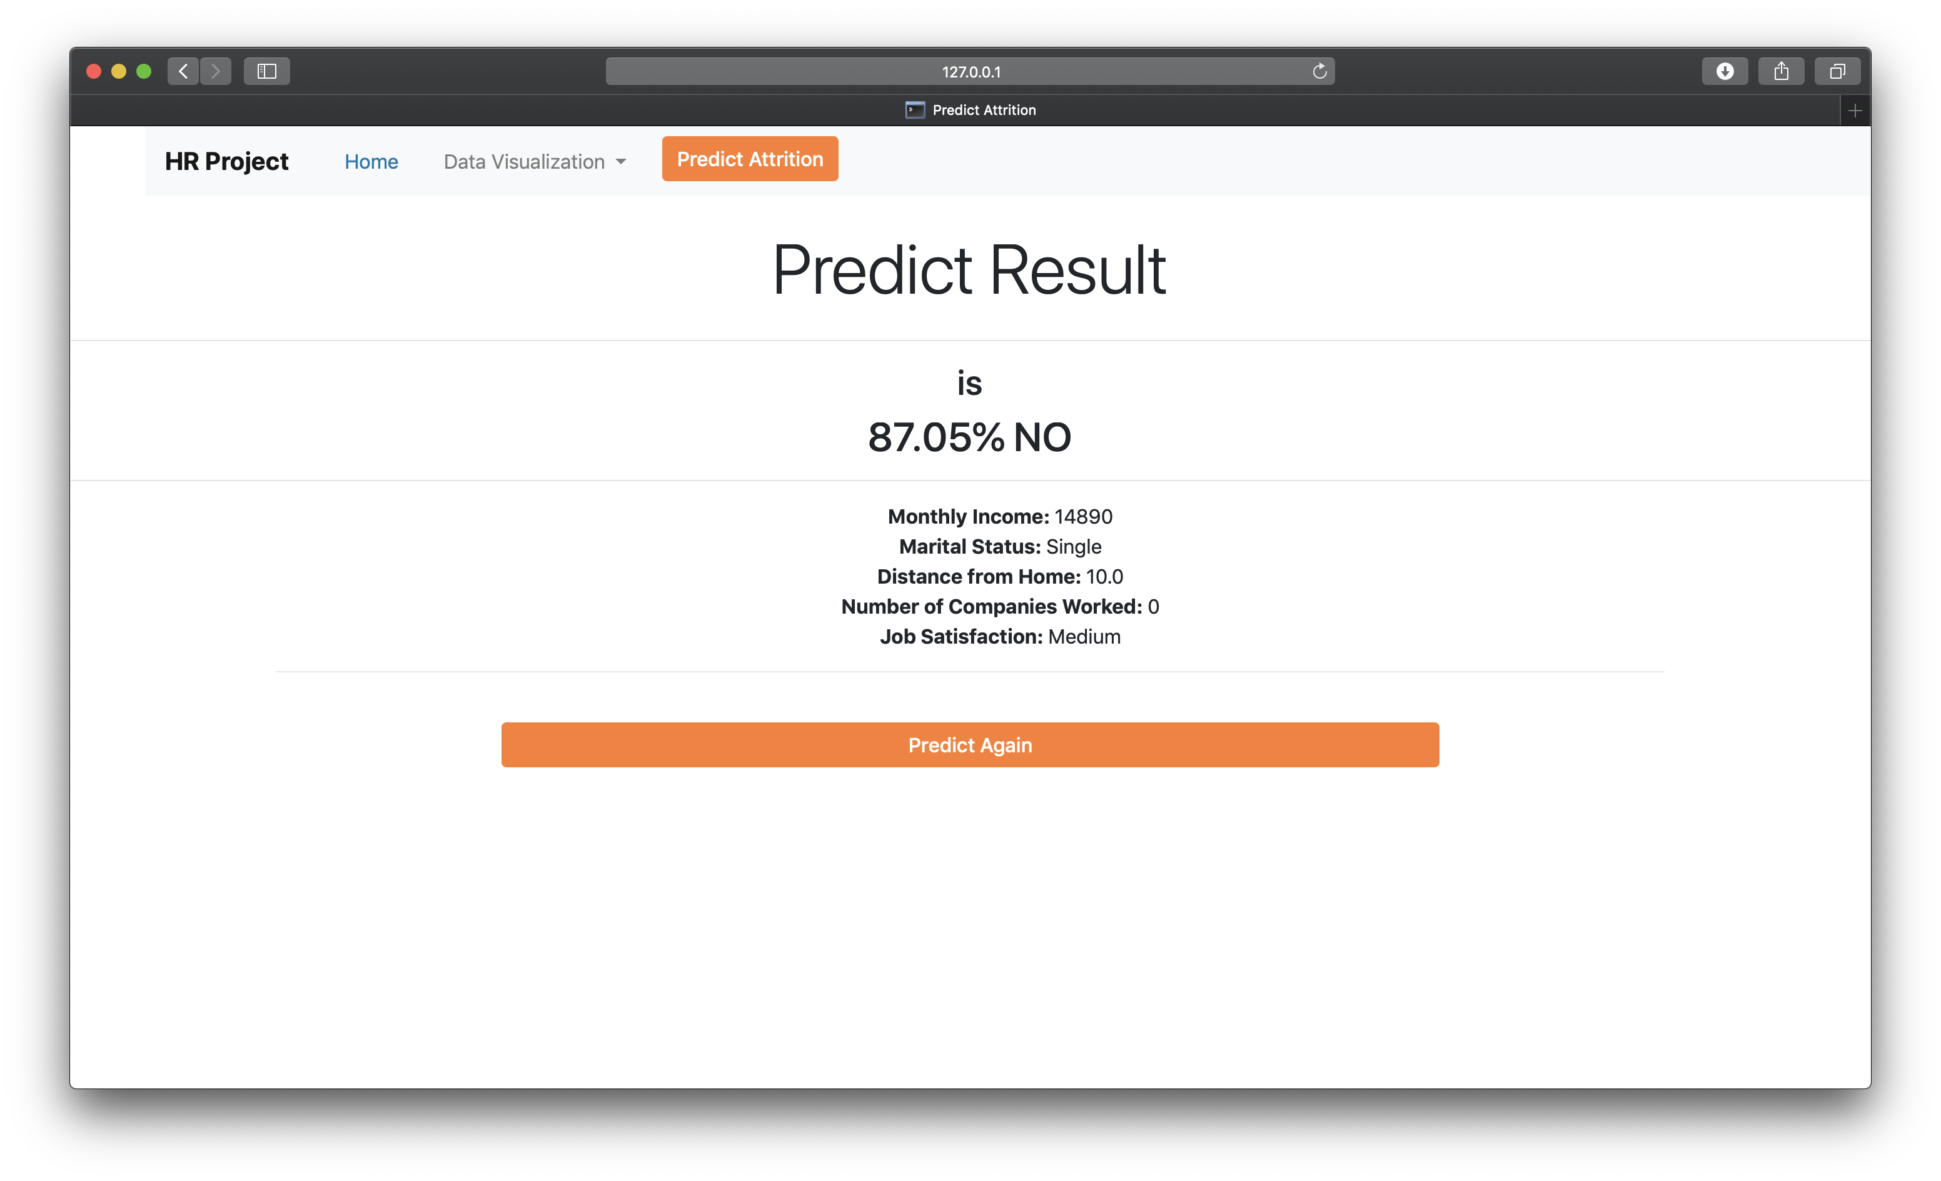
PREDICT RESULT

Slide 21
CONCLUSION & SUGGESTIONS
CONCLUSION
The factors that the management have to focus on are Monthly Income, Marital Status, Number of Companies Worked, Distance from Home, and Job Satisfaction.
We can predict new employee’s attrition using Support Vector Classifier, with a high accuracy score of 97,7%.
SUGGESTIONS
The management can address the factors that can be changed which are Monthly Income, Distance from Home, and Job Satisfaction.
Factors such as Marital Status and Number of Companies Worked can be kept in mind for future employee recruitment.

Slide 22
THANK YOU

